Slide 1
Tech Selector
Iteration 3 Class & Sequence Diagrams

Slide 2
Class Diagrams

Slide 3
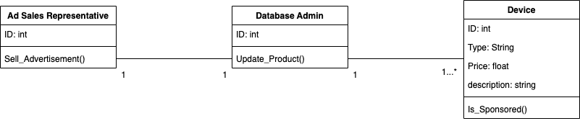
03.02 Deal/Listing Creation

Slide 4
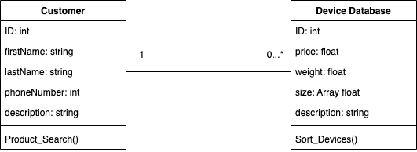
05.01 Sort Through the Database

Slide 5
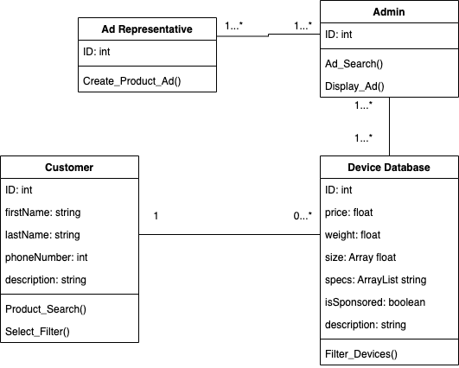
05.03 Showing Sponsored Devices

Slide 6
Sequence Diagrams

Slide 7
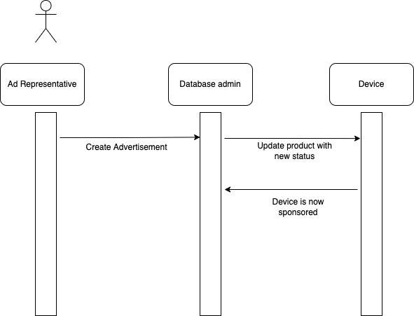
03.02 Deal/Listing Creation

Slide 8
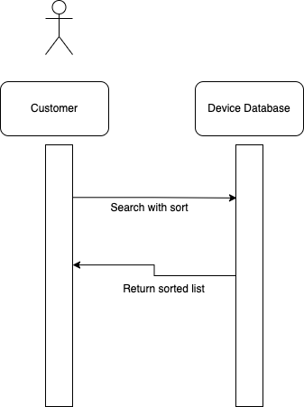
05.01 Sort Through the Database

Slide 9
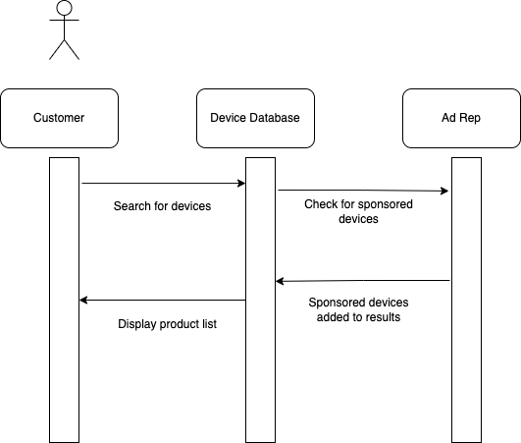
05.03 Showing Sponsored Devices

